Slide 1
Molecular Orbital Theory

Slide 2
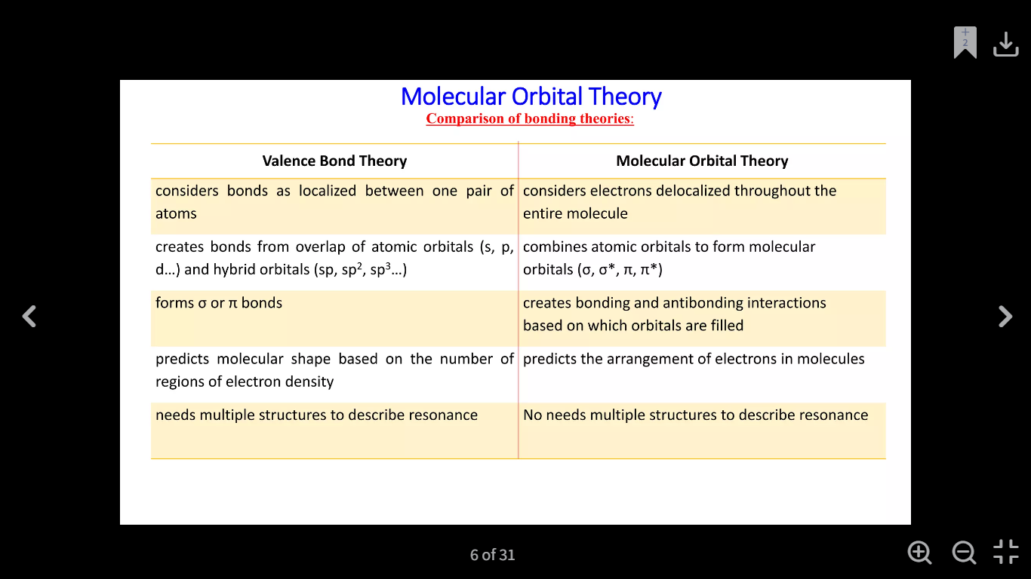

Slide 3
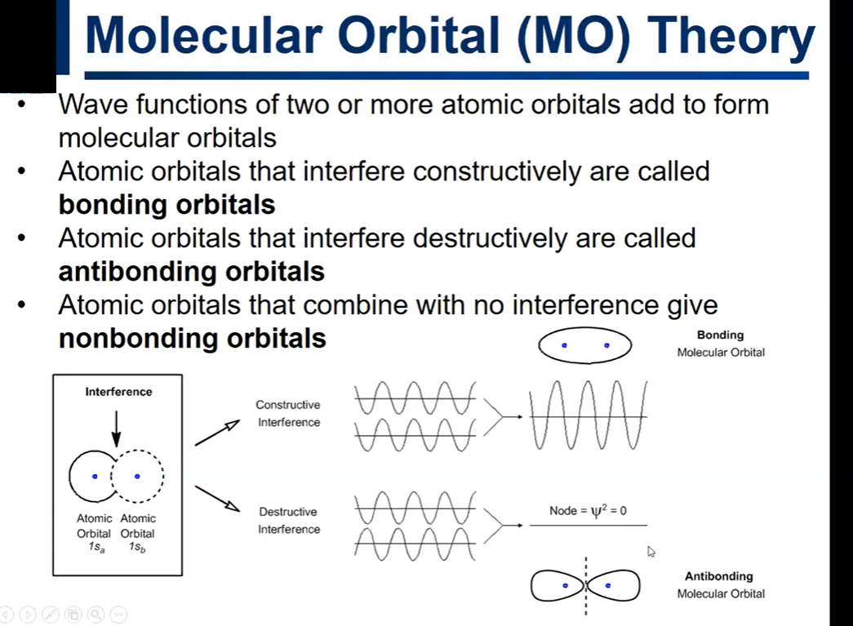


Slide 4
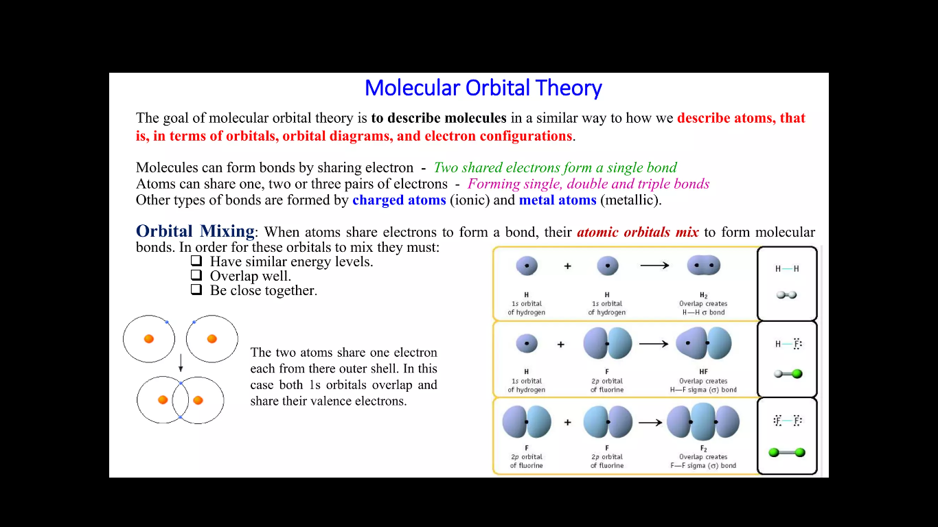

Slide 5
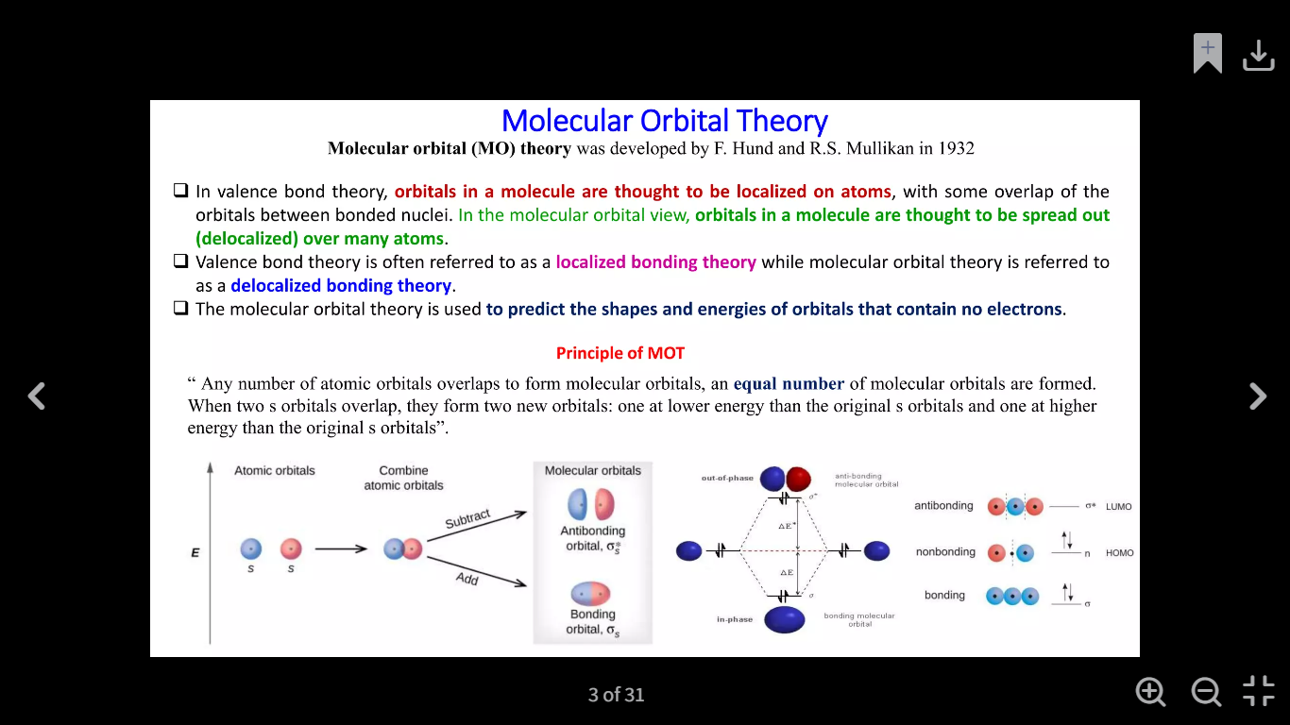

Slide 6
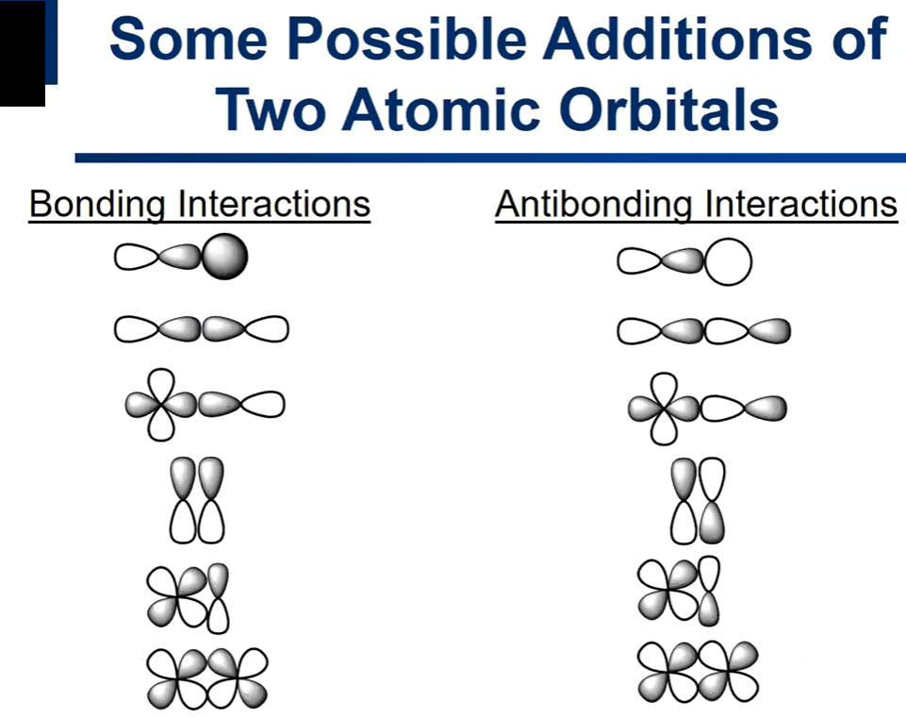

Slide 7
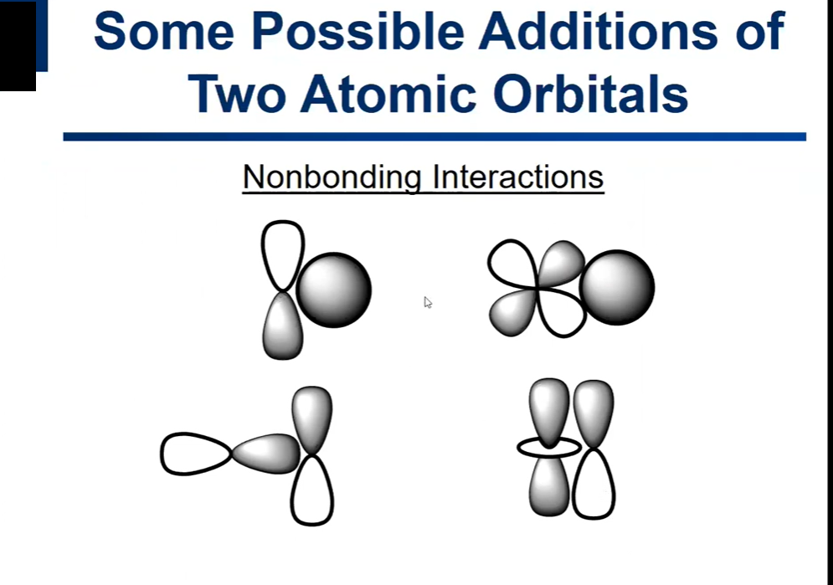

Slide 8
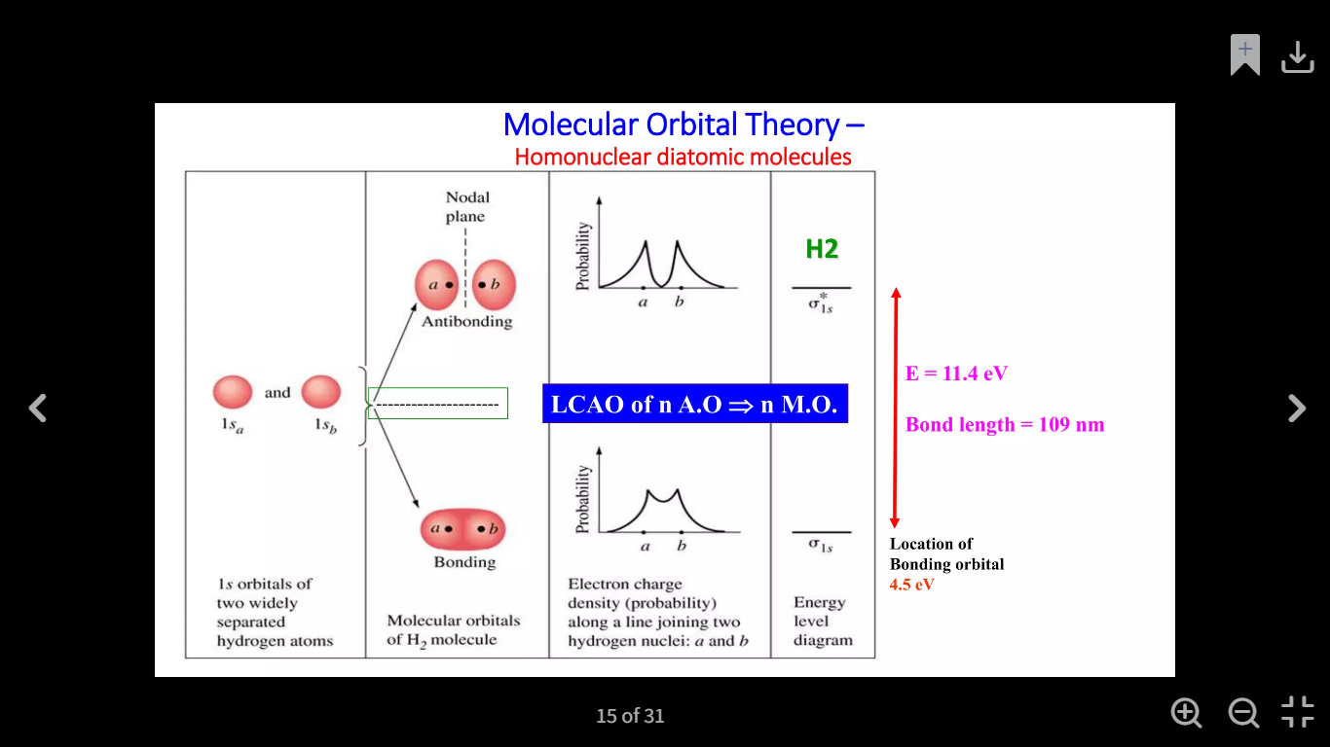

Slide 9
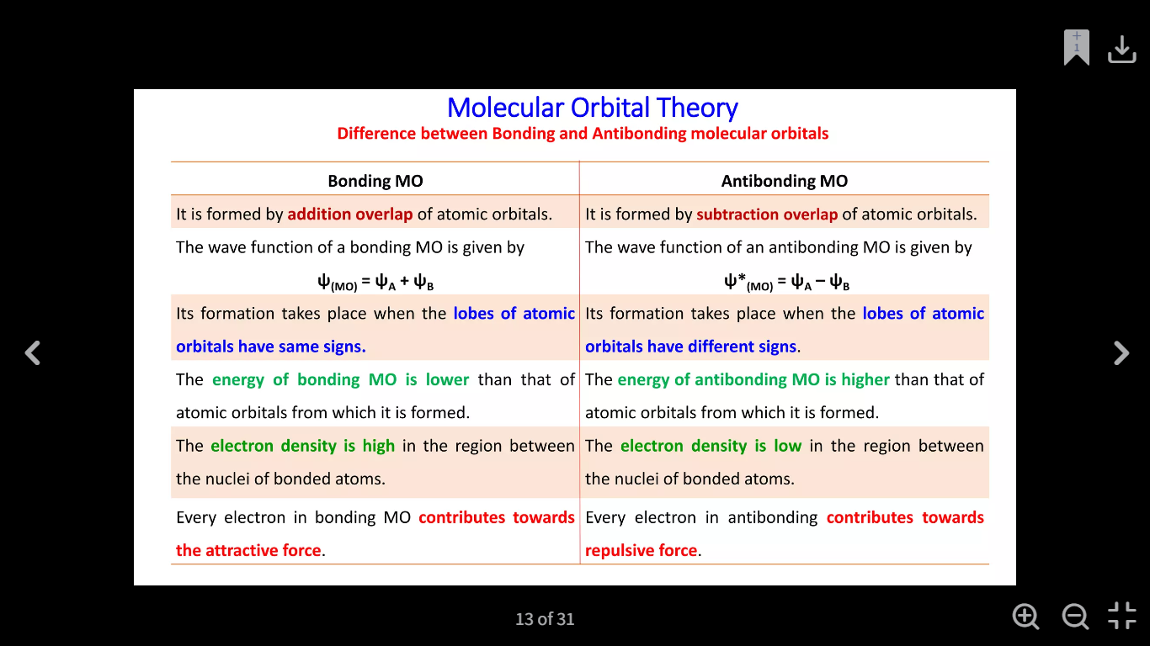

Slide 10
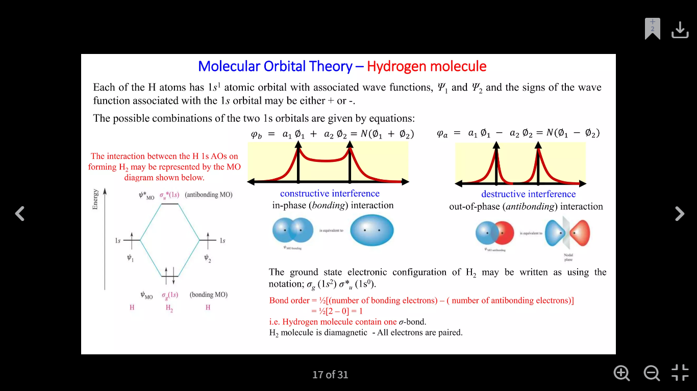

Slide 11
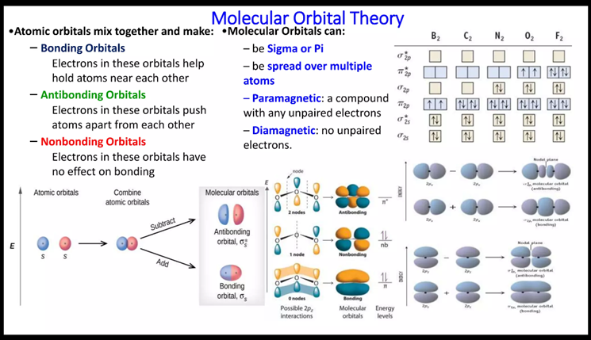

Slide 12
Molecular Orbitals of H₂
Basis set of orbitals consists of only the 1s orbital on each H-atom
Linear combinations of these orbitals produce two molecular orbitals
+ combination gives bonding orbital σ(1s) (constructive interference between wavefunctions
- combination gives antibonding orbital σ*(1s) (destructive interference)

Slide 13
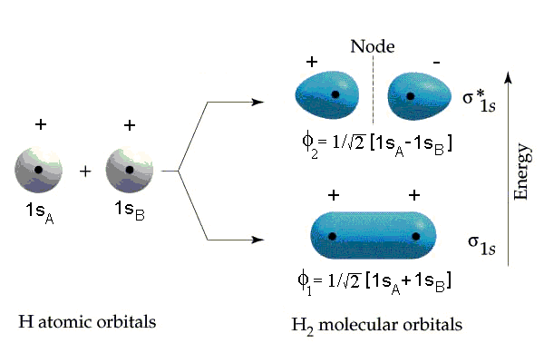
Molecular Orbitals of H₂

Slide 14
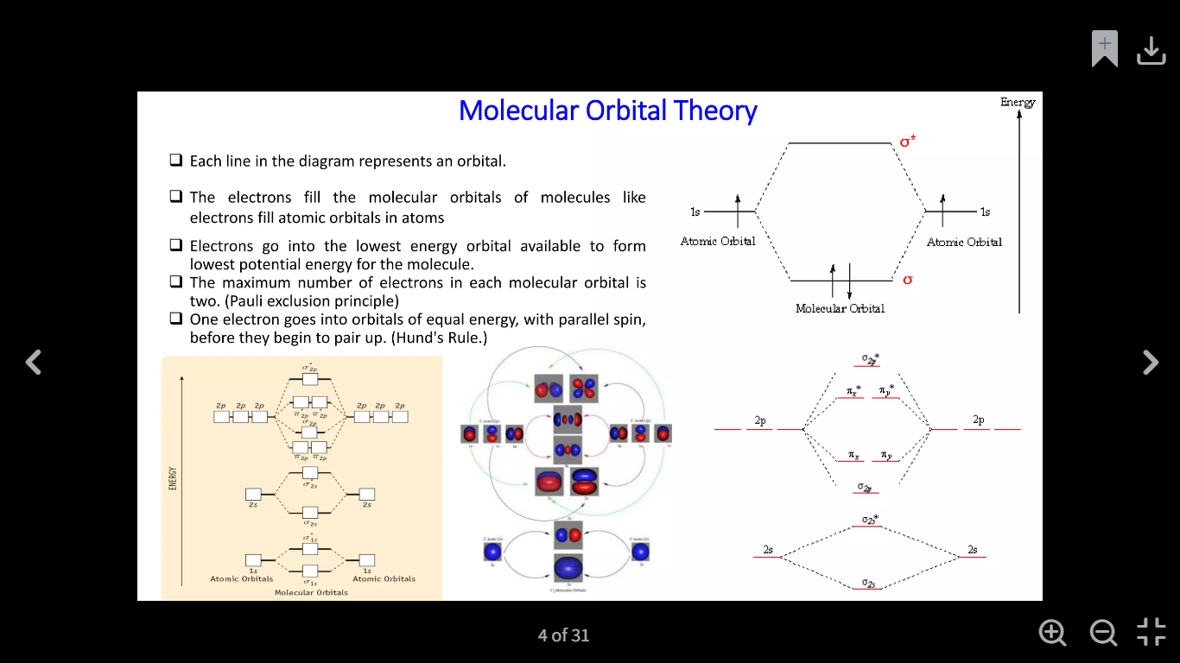

Slide 15
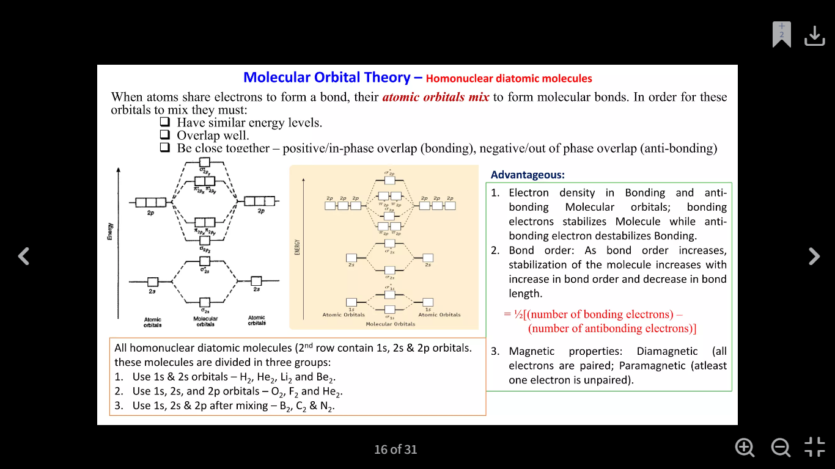

Slide 16
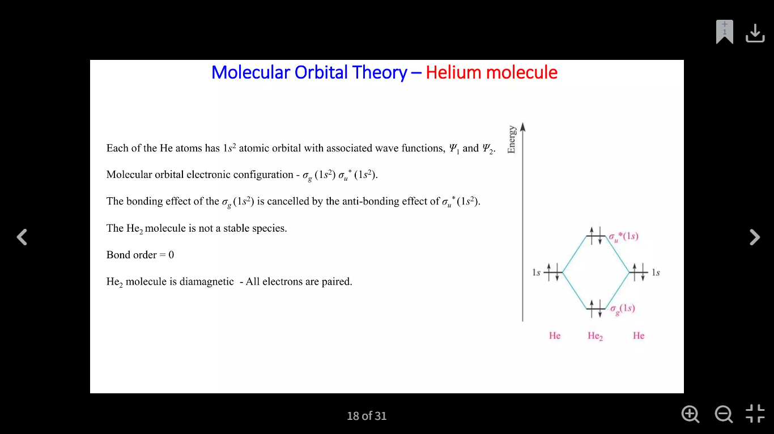

Slide 17
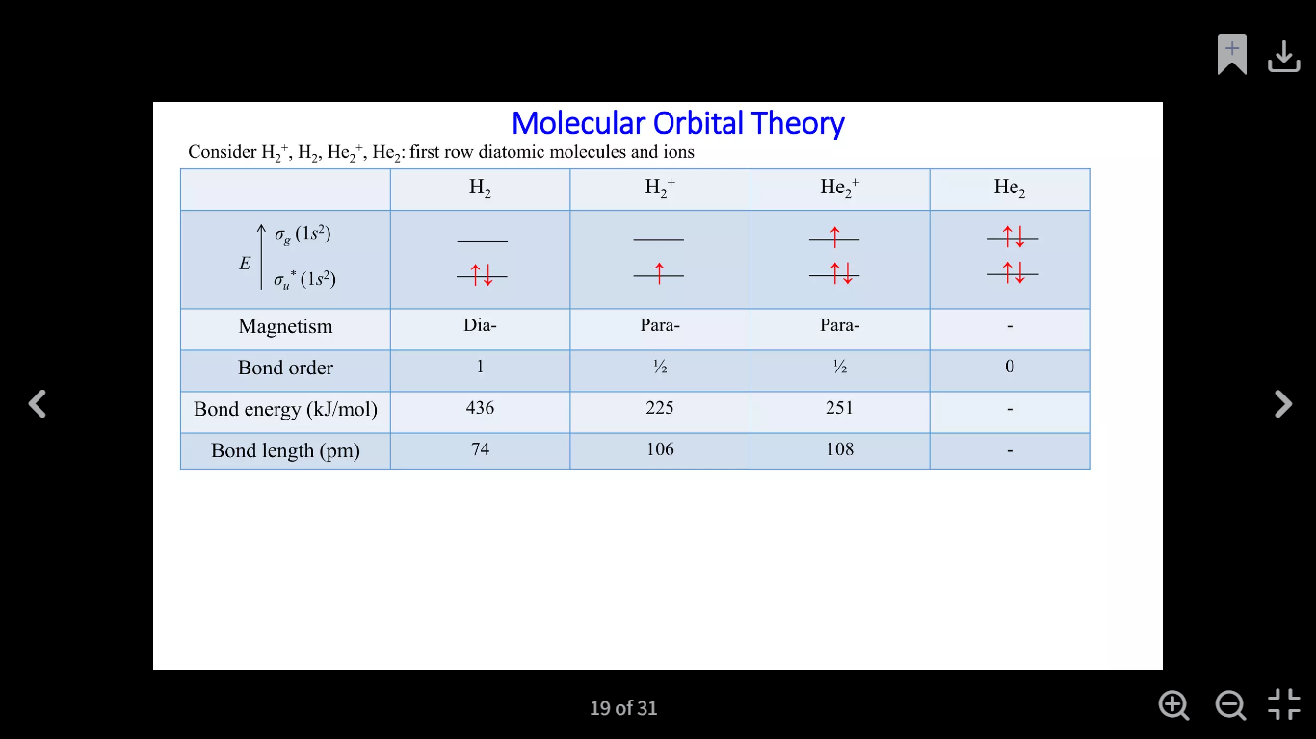

Slide 18
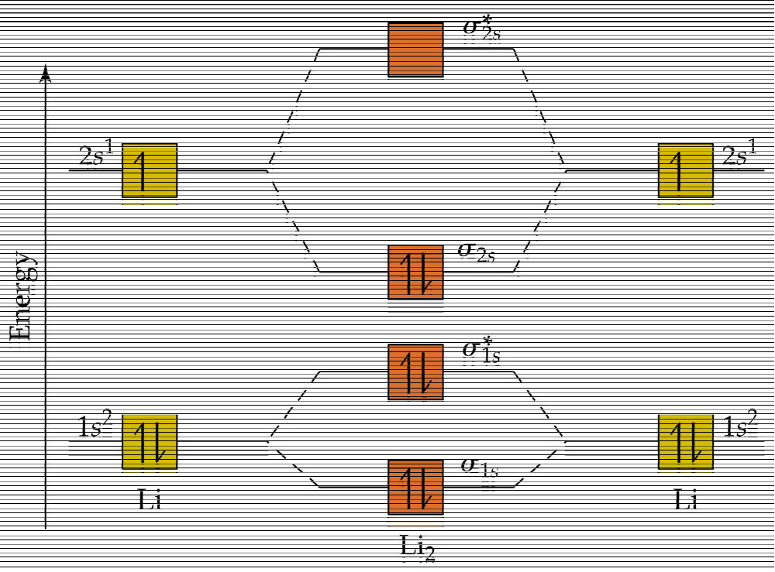
Molecular Orbitals of Li₂
NOTE: Both bonding and antibonding orbitals arising from the 1s orbitals are filled – no net bonding results from core electrons!

Slide 19
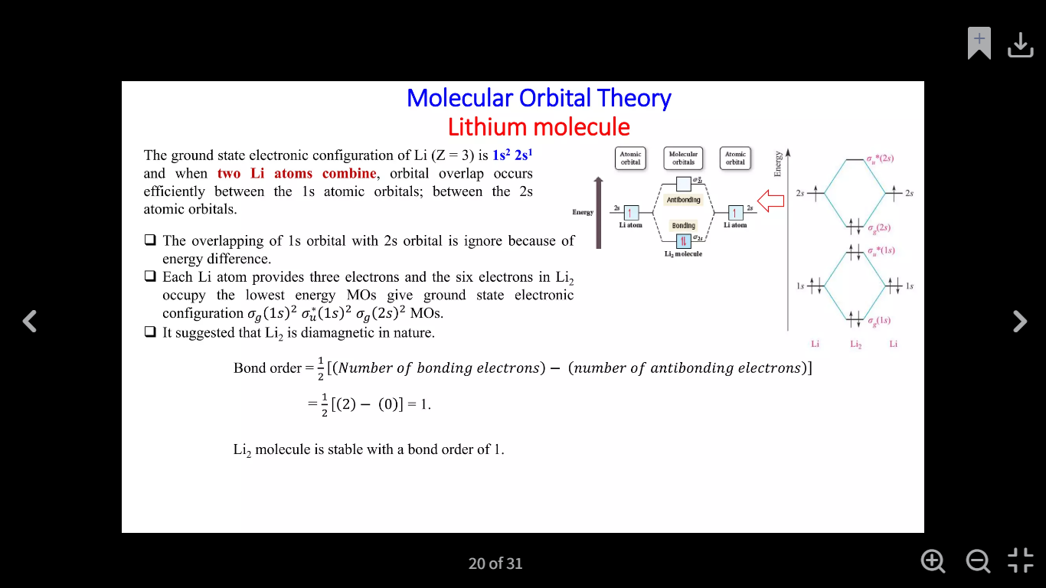

Slide 20
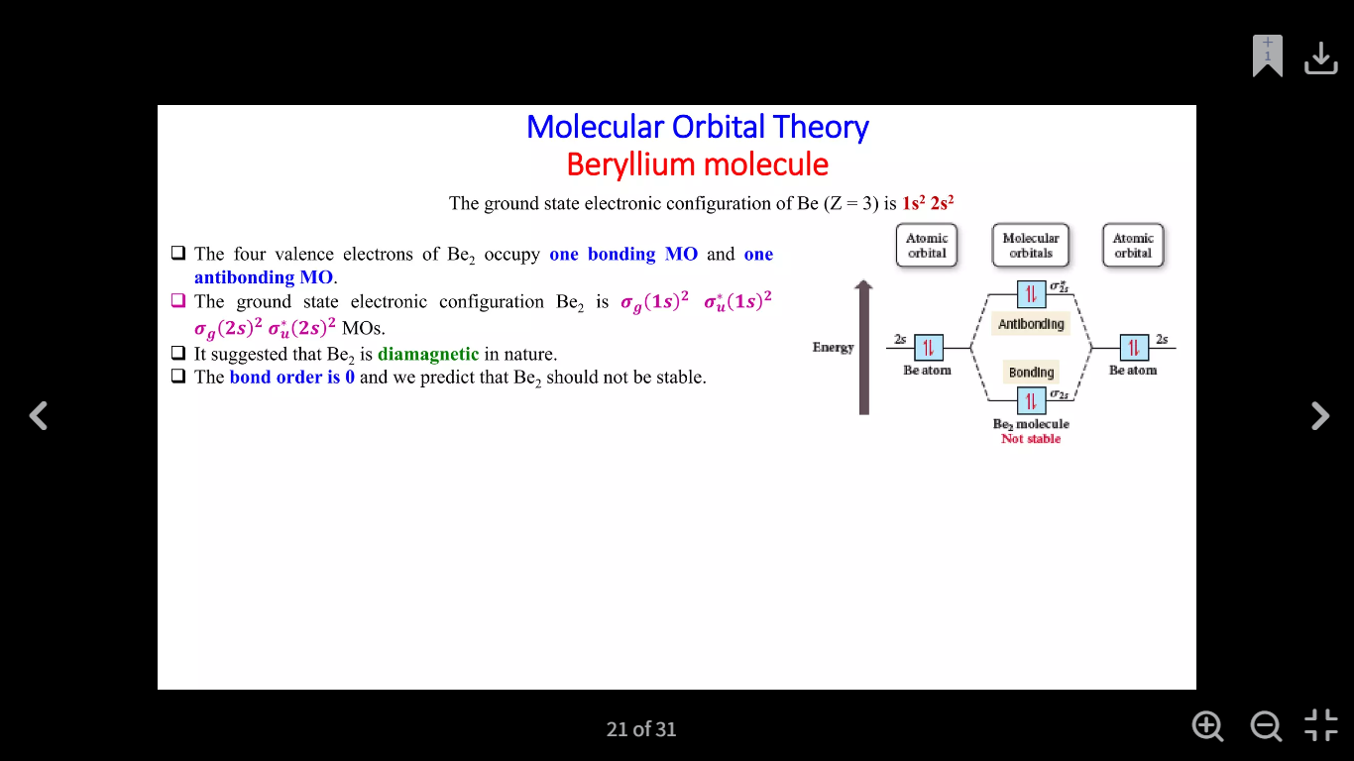

Slide 21
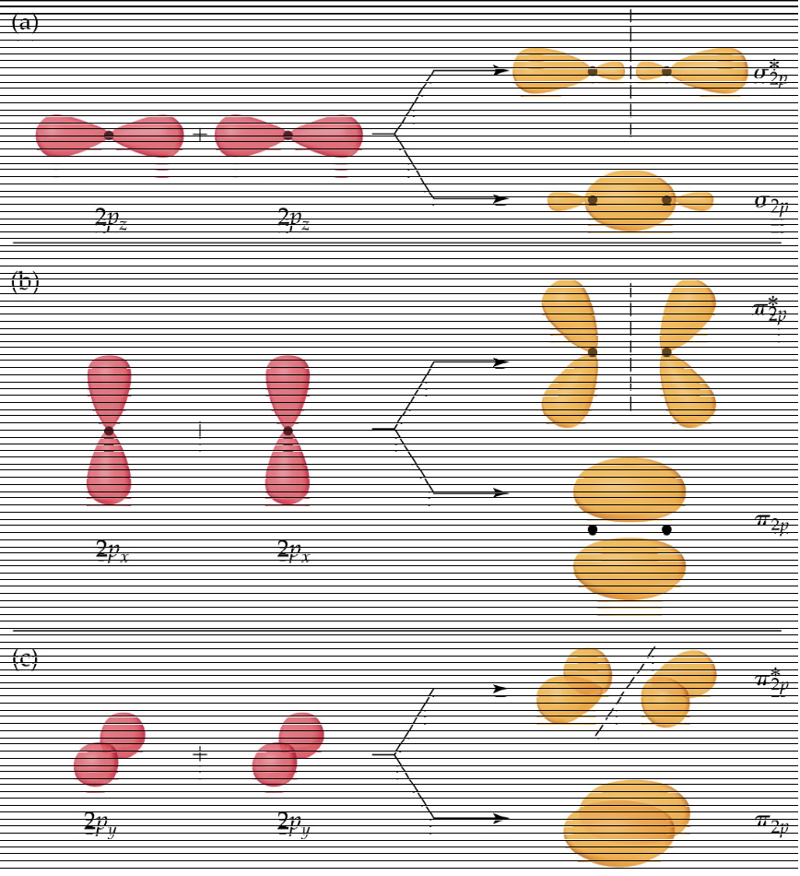
p-Orbital overlap modes

Slide 22
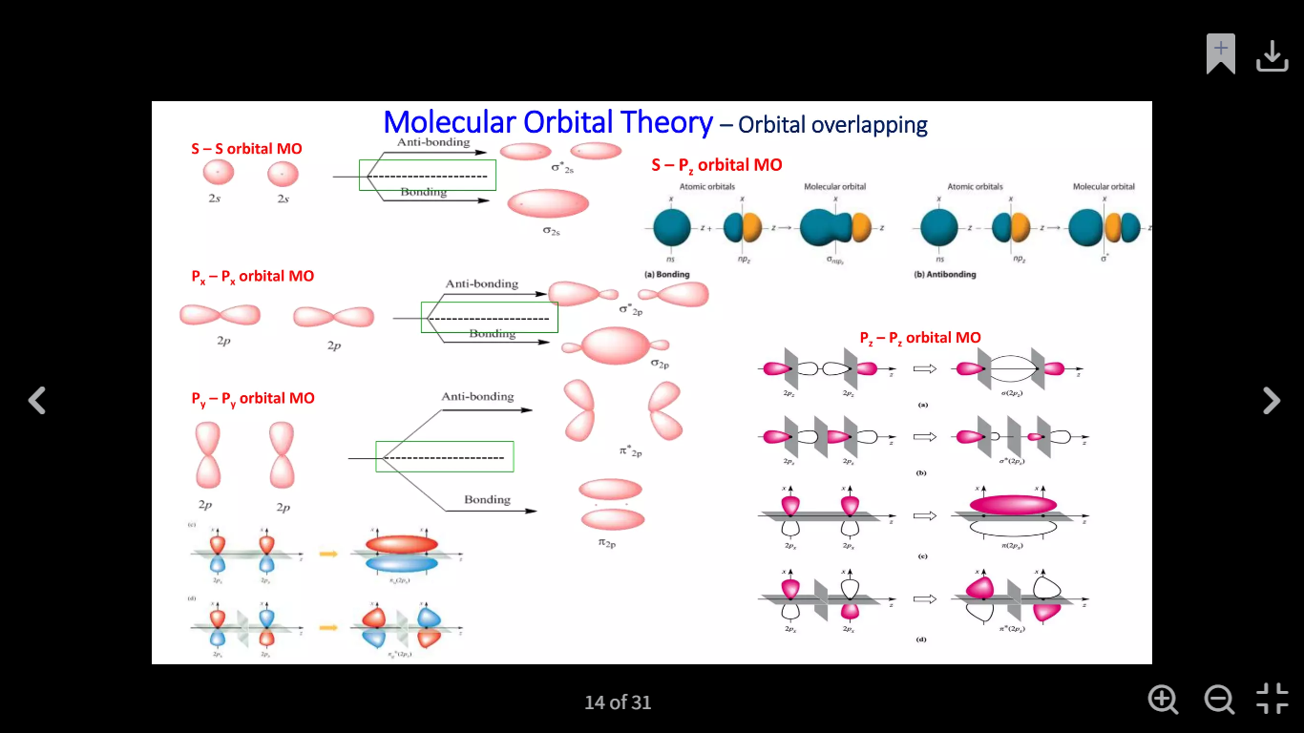

Slide 23
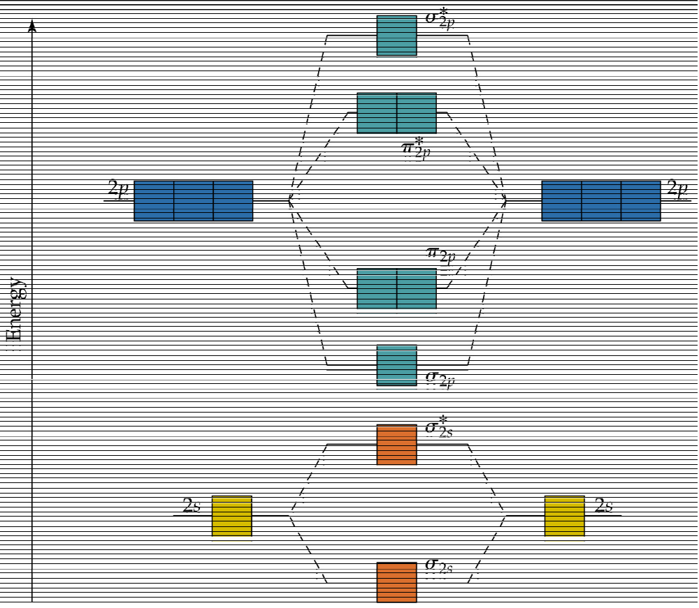
Homonuclear Diatomic with p-Orbitals

Slide 24
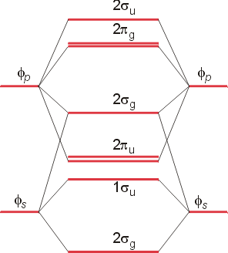
Effect of s-p interaction
For atoms early in the 2nd period, energy separation between 2s and 2p
orbitals is small. This allows mixing of σ(2s) and σ(2p) orbitals that
raises the energy of the s(2p) orbital above that of the π(2p)

Slide 25
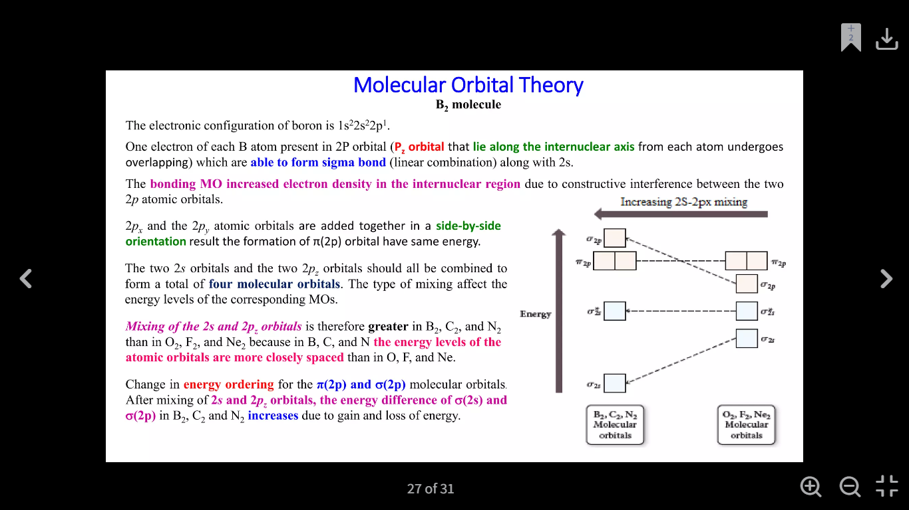

Slide 26
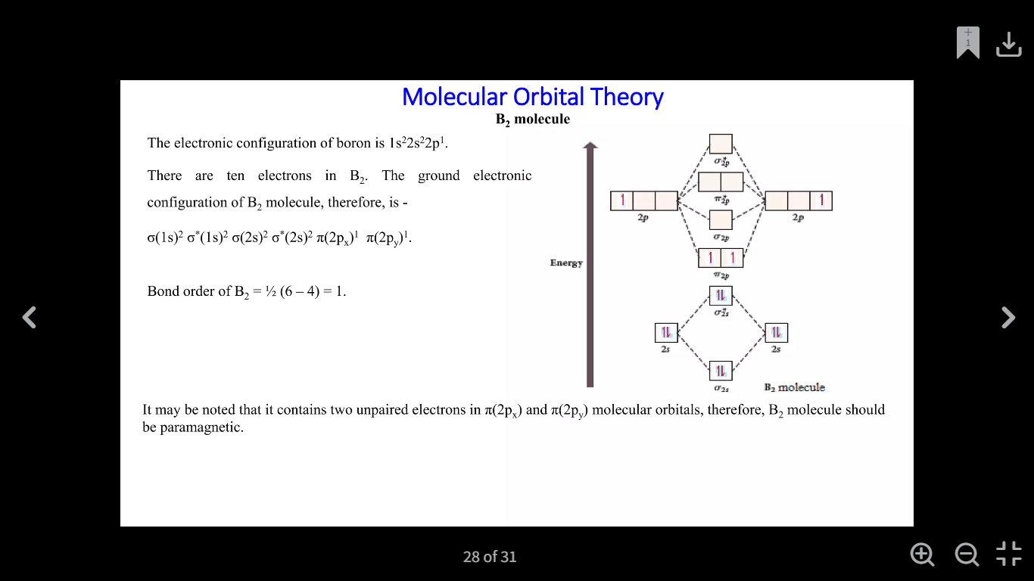

Slide 27
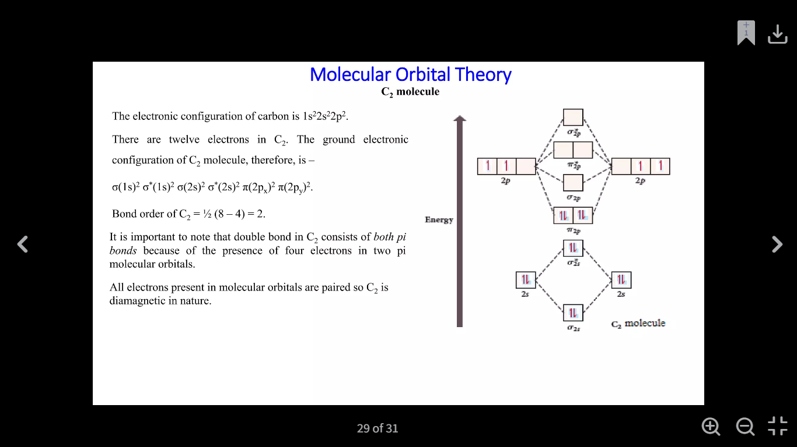

Slide 28
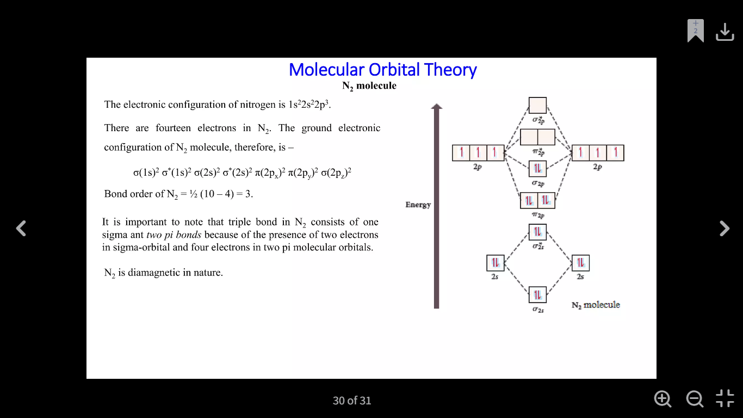

Slide 29
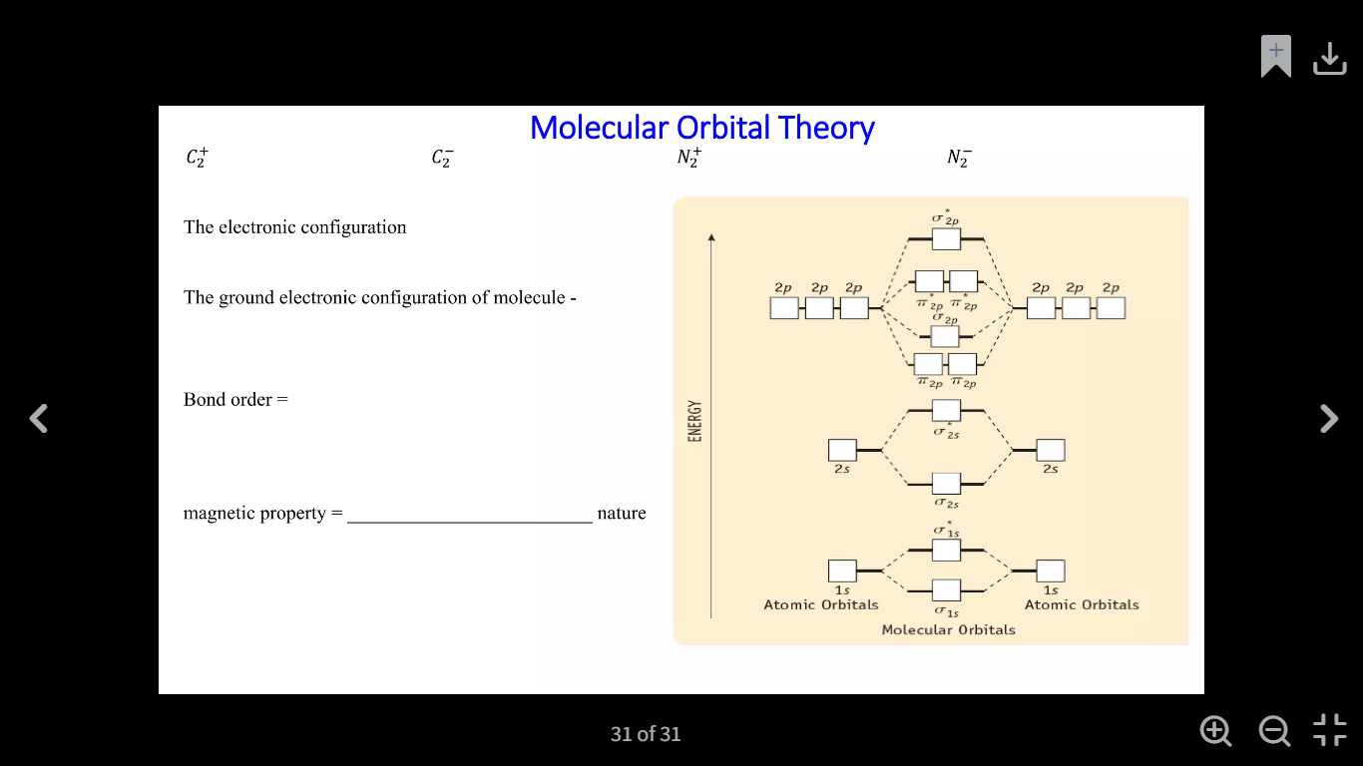

Slide 30
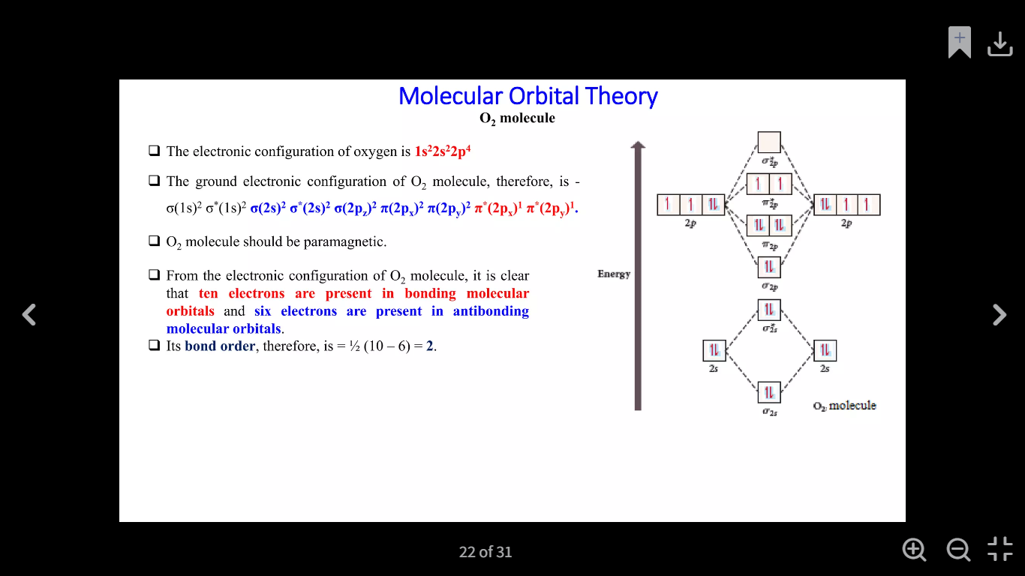

Slide 31
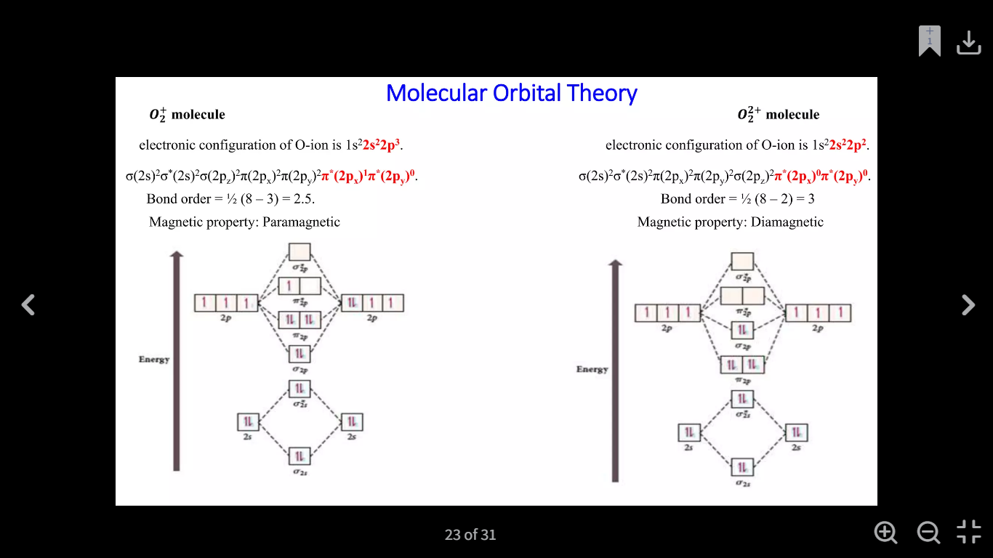

Slide 32
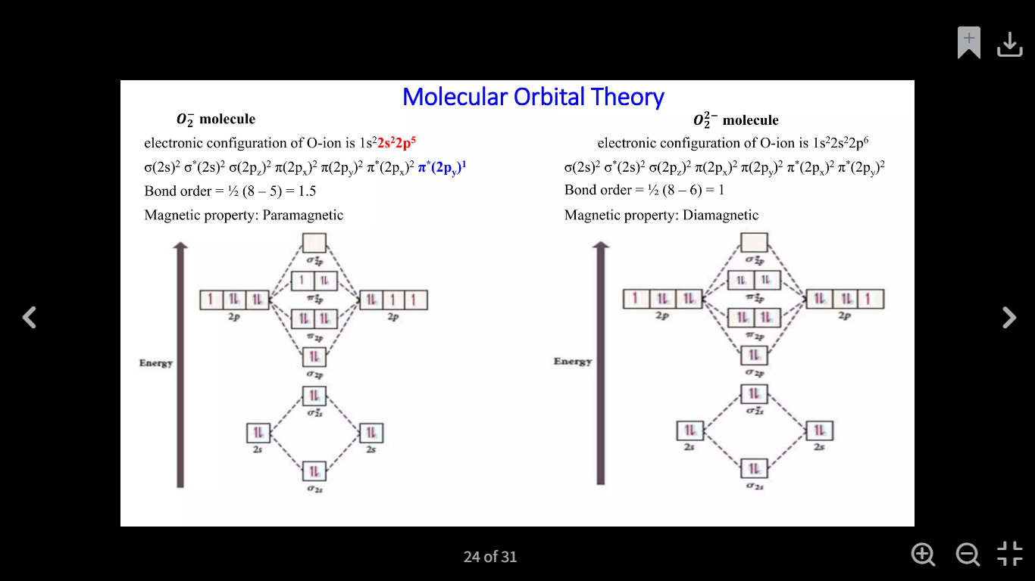

Slide 33
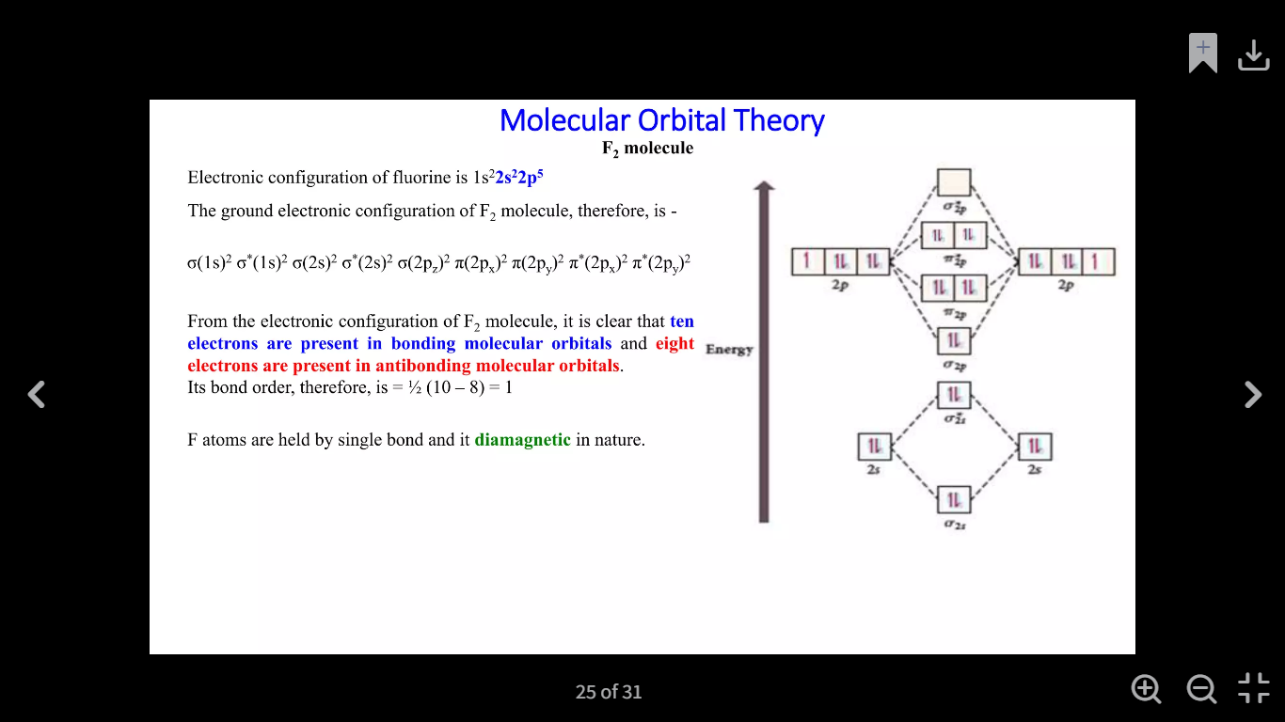

Slide 34
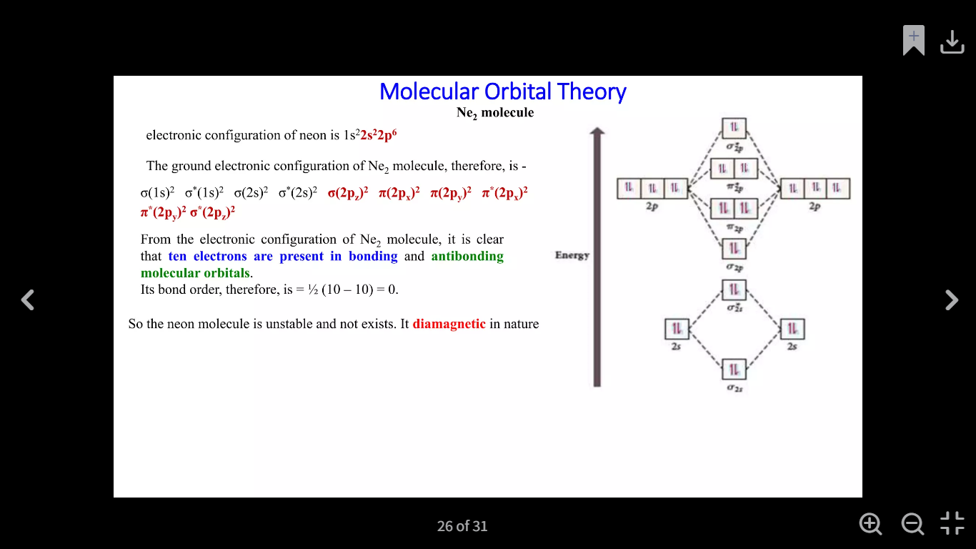

Slide 35
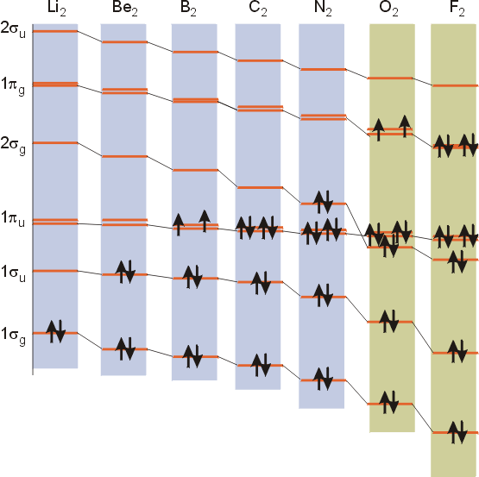
Molecular Orbital diagrams for 2nd row diatomics
σ_{2p}*
Π_{2p}*
σ_{2p}
Π_{2p}
σ_{2s}*
σ_{2s}

Slide 36
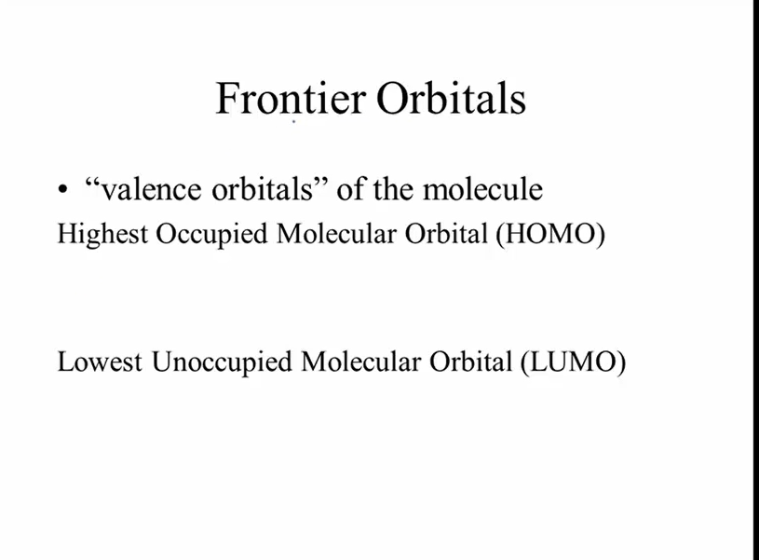

Slide 37
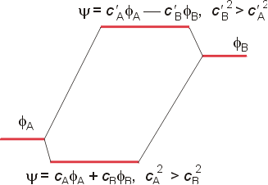
Heteronuclear Diatomics
Strength of orbital interactions depends upon:
Symmetry match
Spatial overlap
Energy overlap

